Slide 1
FACET: Robust Counterfactual Explanation Analytics
Peter VanNostrand, Huayi Zhang, Dennis Hofmann, and Elke A. Rundensteiner
ACM SIGMOD 2024, June 9th – 14th
Notes:
TODO: Progress slider in footer

Slide 2
Notes:
person by Bob Smith from the Noun Project
Bank by Kantor Tegalsari from the Noun Project
House by b farias from the Noun Project
Money by Rainbow Designs from the Noun Project
credit cart by Larea from the Noun Project
Income by Kantor Tegalsari from the Noun Project
bill by SD (design) from the Noun Project
safe by Vasily Gedzun from the Noun Project
Shrug by Kimi Lewis from the Noun Project

Slide 3
!?
Notes:
person by Bob Smith from the Noun Project
Bank by Kantor Tegalsari from the Noun Project
House by b farias from the Noun Project
Money by Rainbow Designs from the Noun Project
credit cart by Larea from the Noun Project
Income by Kantor Tegalsari from the Noun Project
bill by SD (design) from the Noun Project
safe by Vasily Gedzun from the Noun Project
Shrug by Kimi Lewis from the Noun Project

Slide 4
That’s just what the machine said

Slide 5
Automated Consequential Decisions
85% of banks use ML in lending and investment decisions^{[1]}
rejected
49 States use ML in pre-trial detention and parole decisions^{[2]}
denied
>90% of F500 companies use automated applicant screening^{[3]}
hired
[1] Transforming Paradigms: A Global AI in Financial Services Survey, University of Cambridge, 2020
[2] Liberty at Risk: Pre-trial Risk Assessment Tools in the U.S., Electronic Privacy Information Center, 2022
[3] Hidden Workers: Untapped Talent, 2021 Harvard Business School Survey
Notes:
AI Runs the World – We Don’t Know How
[3] https://www.hbs.edu/managing-the-future-of-work/Documents/research/hiddenworkers09032021.pdf

Slide 6
Why?

Slide 7
Why was my ____ classified as ____ rather than ____?
loan application
rejected
accepted
parole request
denied
approved
resume
hired
hired

Slide 8
Counterfactual Question
Why was my ____ classified as ____ rather than ____?
$$x$$
A
B
Observed Instance
Factual Outcome
(undesired)
Counterfactual Outcome
(desired)
How was the decision was made?
What can I do about?

Slide 9
State-of-the-Art: Counterfactual Examples
REJECTED
$$x$$
Income | Rent | Savings | Debt
$3,000 | $1,500 | $4,000 | $850
$$x$$
Minimize distance fn
$$δ\left(x,x^{′}\right)$$
Integer Programming
$$x′$$
ACCEPTED
$$x^{′}$$
Income | Rent | Savings | Debt
$4,000 | $1,500 | $6,000 | $850
SOTA [4-7]
Reject
Accept
[4] Dhurandhar et al. 2019. Model Agnostic Contrastive Explanations for Structured Data. CoRR
[5] Tolomei, et al. 2017. Interpretable Predictions of Tree-based Ensembles via Actionable Feature Tweaking. SIGKDD
[6] Parmentier et al. 2021. Optimal Counterfactual Explanations in Tree Ensembles. ICML
[7] Fernández et al. 2020. Random forest explainability using counterfactual sets. Information Fusion

Slide 10
Challenge 1: Explanation Personalization
REJECTED
ACCEPTED
Income | Rent | Savings | Debt
$3,000 | $1,500 | $4,000 | $850
Income | Rent | Savings | Debt
$4,000 | $1,500 | $6,000 | $850
Unalterable Features
Feature Restrictions
Feature Priorities
My boss won’t give me a raise
Apartments near
my work cost
$2-$2.2k
I’d rather wait and save than get a new job
10

Slide 11
Challenge 1: Explanation Personalization
REJECTED
ACCEPTED
Income | Rent | Savings | Debt
$3,000 | $1,500 | $4,000 | $850
Income | Rent | Savings | Debt
$4,000 | $1,500 | $6,000 | $850
I can do that!
Actionable
I can’t do that!
Not Actionable
Users can’t painstakingly enumerate every criteria that are actionable for them
11

Slide 12
Challenge 2: Explanation Robustness
ACCEPTED
Savings Balance $$
$$x^{′}$$
Income | Rent | Savings | Debt
$4,000 | $1,500 | $6,000 | $850
Great!
$6,000

Slide 13
Challenge 2: Explanation Robustness
ACCEPTED
Savings Balance $$
$$x^{′}$$
Income | Rent | Savings | Debt
$4,000 | $1,500 | $6,000 | $850
Great!
$6,000

Slide 14
Challenge 2: Explanation Robustness
ACCEPTED
Savings Balance $$
$$x^{′}$$
Income | Rent | Savings | Debt
$4,000 | $1,500 | $6,000 | $850
Umm?
$6,000

Slide 15
Challenge 2: Explanation Robustness
ACCEPTED
Savings Balance $$
$$x^{′}$$
Income | Rent | Savings | Debt
$4,000 | $1,500 | $6,000 | $850
Oh no.
$6,000

Slide 16
Challenge 2: Explanation Robustness
$6,001
?
ACCEPTED
$$x^{′}$$
Income | Rent | Savings | Debt
$4,000 | $1,500 | $6,000 | $850
$6,000
$5,999
?

Slide 17
Challenge 2: Explanation Robustness
Counterfactual examples leave critical outcomes up to chance

Slide 18
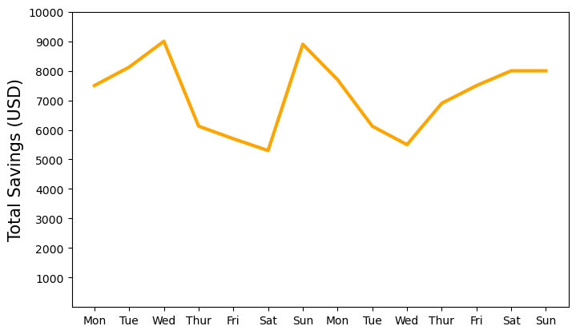
Challenge 3: Explanation Efficiency
$$approve=f\left(\text{rent}, \text{income}, \text{debt}, \text{savings}\right)$$
$$income=\$3,500$$
$$income=\$4,000$$
$$income=\$4,500$$
18

Slide 19
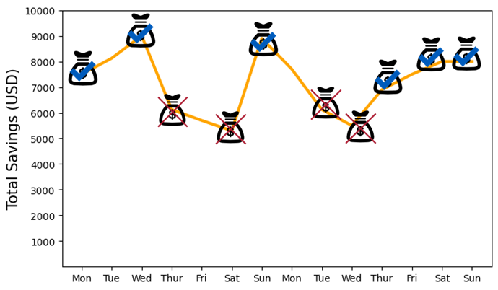
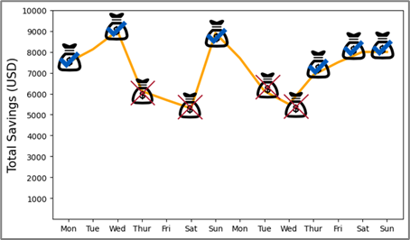
Challenge 3: Explanation Efficiency
$$income$$
$$rent$$
$$debt$$
$$N$$
Explanation difficulty is exponential in the number of features
For models such as Random Forest optimal explanation is NP-Hard^{[8]}
Integer programming becomes incredibly slow
[8] Zhicheng Cui, Wenlin Chen, Yujie He, and Yixin Chen. Optimal Action Extraction for Random Forests and Boosted Trees. SIGKDD 2015
19
Notes:
Small increases in latency decrease user interactions and reduced user understanding
[?] The Effects of Interactive Latency on Exploratory Visual Analysis, IEEE Transactions on Visualization and Computer Graphics 2014

Slide 20
Explanation Goals
Personalized
Robust
Efficient
Tailor explanations to user’s real-world circumstances
Explanations hold with feature variations
Generate explanations in tractable time

Slide 21
Proposed Approach: FACET
The first real time interactive system for generating robust personalized counterfactual explanations
FACET: Fast Actionable Counterfactuals for Ensembles of Trees
Personalized Explanation Query
FACET Explanation Interface
Explanation
Analytics Engine
Counterfactual Region
Index
Robust Explanation

Slide 22
Solution 1: Interactive Explanations
One-shot minimization task
Human-centric interaction
Explanation as a database analytics task
ML Model
FACET
Income | Rent | Savings | Debt
$4,000 | $1,500 | $6,000 | $850
Explanation Database
SELECT TOP-EXPLANATIONS(K)
WITH WHAT-IF SPECULATION:
Income < $4,000
WITH UNALTERED FEATURES:
Gender, Rent
ORDER BY DISTANCE(X) WITH WEIGHT W
Diverse + plausible set of explanation candidates
User Knowledge
Income | Rent | Savings | Debt
$3,500 | $1,500 | $7,000 | $500

Slide 23
Solution 1: Interactive Explanations
FACET
Find me an explanation that…
Doesn’t require changing my rent
Prioritizes changing savings over income
Has a savings between $4,000 and $6,000
And a debt between $500 and $700
Explanation Database
User Knowledge
Iterative querying supports users to quickly explore and compare possible explanations
Personalized
Robust
Efficient

Slide 24
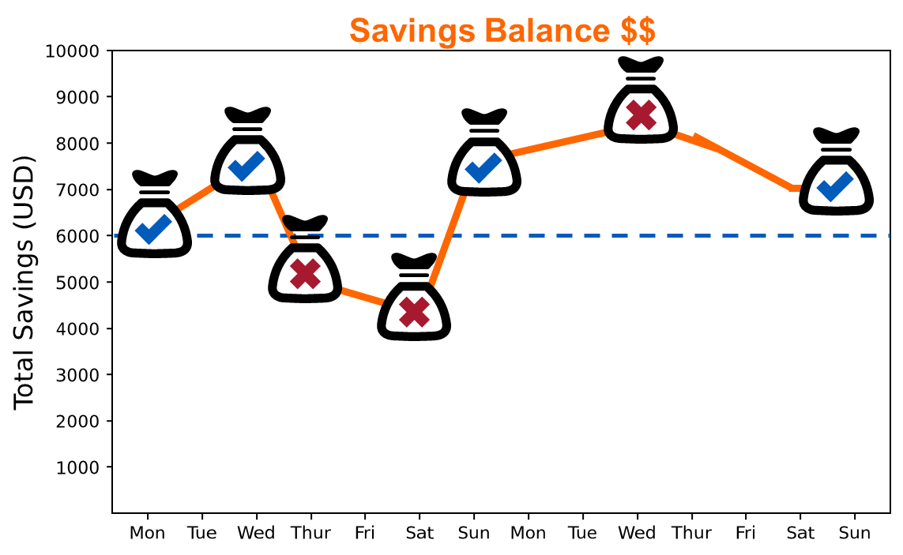
Solution 2: Counterfactual Regions
Counterfactual Example
$$x$$
Reject
$$x′$$
Accept
$$x^{′′}$$
$$x^{′′}$$
ACCEPTED
$$x^{′}$$
Income | Rent | Savings | Debt
$4,000 | $1,500 | $6,000 | $850

Slide 25
Solution 2: Counterfactual Regions
Counterfactual Example
Counterfactual Region
Robustness Guarantee
$$\left|v\right|≤α→f\left(x^{′}+v\right)=B$$
$$x$$
$$x$$
Reject
$$x′$$
$$x^{′′}$$
$$x^{′′}$$
$$R$$
$$x^{′}$$
Accept
$$x^{′′}$$
$$α$$
$$v$$
$$x^{′′}$$
ACCEPTED
distance fn
relaxation factor
$$x^{′}$$
Income | Rent | Savings | Debt
$4,000 | $1,500 | $6,000 | $850
$$R=\left\{∀x_{i}^{′}∈\left[x_{i}∈𝒳 | δ\left(x^{′},x_{i}\right)≤α\right], f\left(x_{i}^{′}\right)=B\right\}$$
All points
neighborhood
counterfactual

Slide 26
Solution 2: Counterfactual Regions
Counterfactual Example
Counterfactual Region
Robustness Guarantee
$$\left|v\right|≤α→f\left(x^{′}+v\right)=B$$
$$x$$
$$x$$
Reject
$$x′$$
$$R$$
$$x^{′}$$
Accept
$$α$$
ACCEPTED
$$x^{′}$$
Income | Rent | Savings | Debt
$4,000 | $1,500 | $6,000 | $850
$$x^{′}$$
Income | Rent | Savings | Debt
$3,500 | $1,500 | $7,500 | $850
$$+ R$$
$$±\$150$$

Slide 27
Solution 2: Counterfactual Regions
Counterfactual Example
Counterfactual Region
Robustness Guarantee
$$\left|v\right|≤α→f\left(x^{′}+v\right)=B$$
$$x$$
$$x$$
Reject
$$x′$$
$$R$$
$$x^{′}$$
Accept
$$α$$
ACCEPTED
$$x^{′}$$
Income | Rent | Savings | Debt
$4,000 | $1,500 | $6,000 | $850
$$x^{′}$$
Income | Rent | Savings | Debt
$3,500 | $1,500 | $7,500 | $850
$$+ R$$
$$±\$75$$
$$±\$75$$
$$±\$75$$
$$±\$75$$

Slide 28
Solution 2: Counterfactual Regions
Your application would be accepted rather than rejected if
your income was between $3,425 and $3,575 and
your savings was between $7,425 and $7,575
Personalized
Robust
Efficient

Slide 29
Solution 3: Intelligent Region Indexing
Ensembles: Random Forest, XGBoost
Counterfactual Regions of Ensembles
N-Dimensional Hyperrectangles
Strong amount of overlap
Highly variable size
x100 Billion Trillion (NP-Hard^{[8]})
Personalized
[8] Zhicheng Cui et. al. Optimal Action Extraction for Random Forests and Boosted Trees. KDD’15
Robust
Efficient

Slide 30
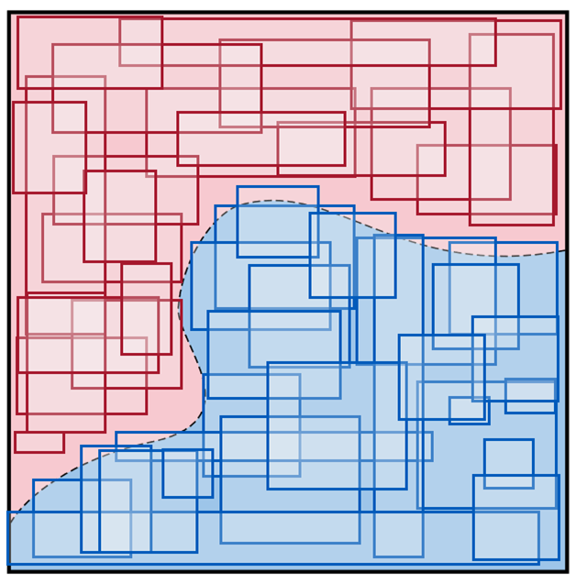
Solution 3: Intelligent Region Indexing
Unrealistic feature-value combinations
useless to real users (non-actionable)
$3k
Rent
Distribution of real data
0
Income
$10k

Slide 31
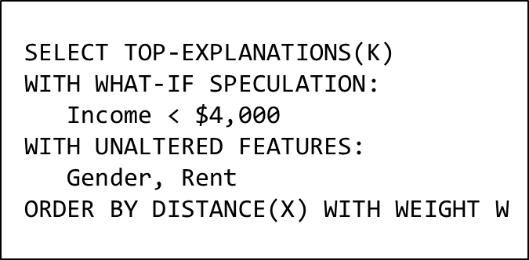
Solution 3: Intelligent Region Indexing
Use domain data to seed regions
😄 Tractable number of regions
😄 Minimal overlap
😦 High Dimension
Analytics = Parametrized, High Dim, Spatial, kNN Search!

Slide 32
Solution 3: Intelligent Region Indexing
x
[2]
Searching every region is slow
Most are not relevant (far) and don’t match user’s constraints
R
R
1
4
$$x$$
R
3
R
R
2
7
R
R
R
R
9
5
6
8
R
R
10
11
R
12
x
[1]

Slide 33
Solution 3: Intelligent Region Indexing
x
[2]
R
R
1
R
3
R
R
2
7
R
R
R
R
9
5
6
8
R
R
10
11
R
12
s
s
x
[1]
1,1
1,2

Slide 34
Solution 3: Intelligent Region Indexing
x
[2]
R
R
Compute the location of each region relative to the partition
Store all results as a bit-vector index
1
4
$$x$$
R
3
s
2,2
R
R
2
7
R
R
R
R
9
s
5
6
8
2,1
Personalized
R
R
Robust
10
11
R
12
Efficient
s
s
x
[1]
1,1
1,2

Slide 35
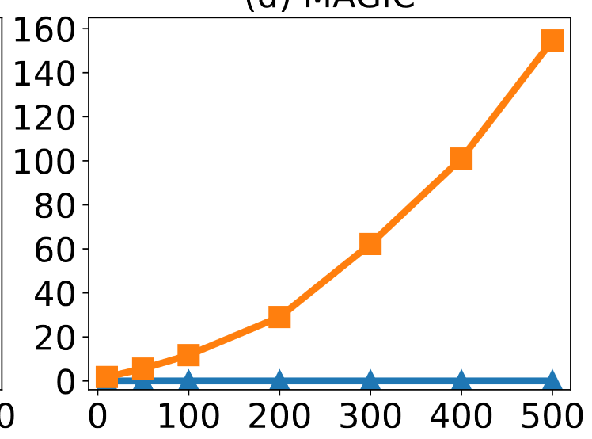
Results Highlights
Explanation Robustness
Explanation Time
Time (sec) for one query
Size of Variation as % of Dataset Size
Ensemble Complexity (# Trees)

Slide 36
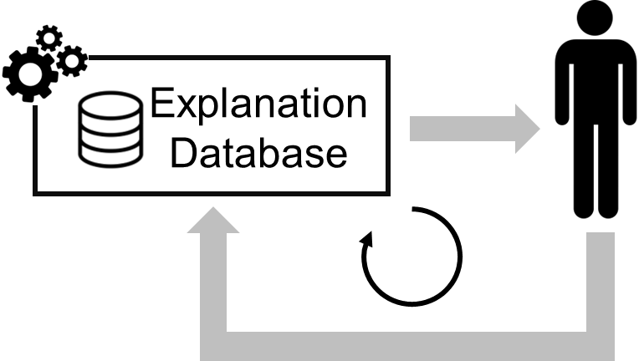
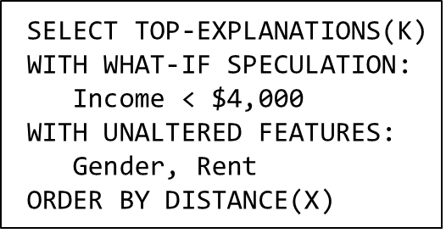
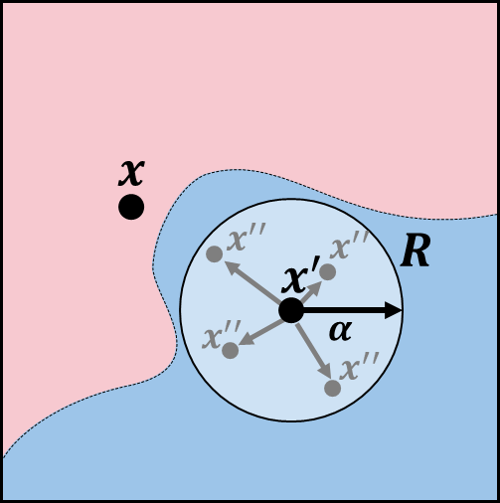
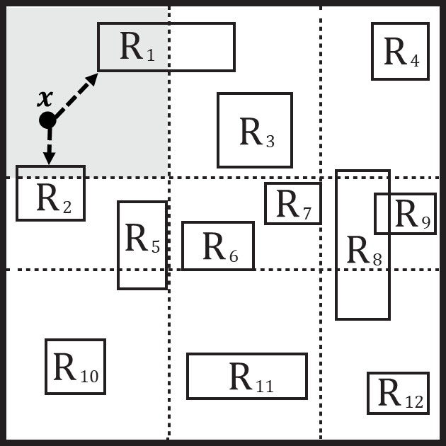
Conclusion + Future Work
FACET System
Conclusion
FACET uses indexing to provide users robust personalized counterfactual explanations in real time
Encourage treating explanation with a database lens
Personalized
Future Work
Generating region explanations for other model types
Advanced region analytics (Diversity? Causality?)
Robust
Efficient

Slide 37
Thank You!
Checkout our paper for full details, code and more!
petervannostrand.github.io
FACET: Robust Counterfactual Explanation Analytics
Peter M. VanNostrand, Huayi Zhang, Dennis M. Hofmann, and Elke A. Rundensteiner.
ACM SIGMOD 2024

