Slide 1
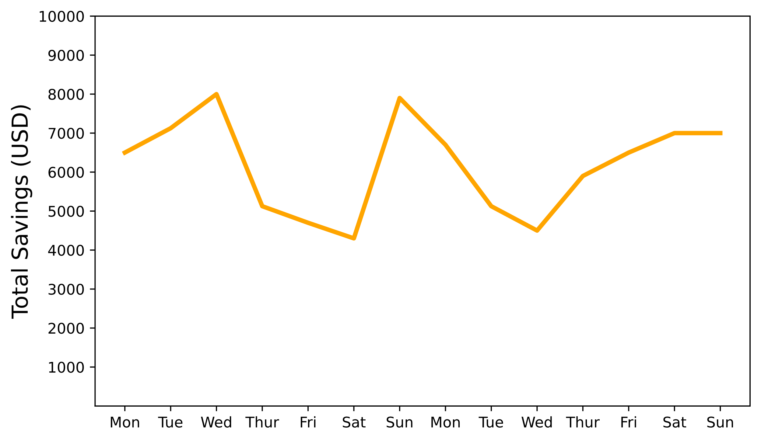
Indexing and querying enables robust interactive explanation of ML decisions
FACET: Robust Counterfactual Explanation Analytics
Peter M. VanNostrand, Huayi Zhang, Dennis Hofmann, Elke A. Rundensteiner
Background: Machine learning systems finance, hiring, criminal sentencing, and more make decisions that can strongly affect people’s lives. Counterfactual explanations systems suggest changes to users to avoid such negative outcomes
I’d like to apply for a loan. Here’s my financial info
Your application is
REJECTED
REJECTED
Reject
Income | Rent | Savings | Debt
$4,000 | $1,500 | $7,000 | $850
Accept
Why? What can I do
to get ACCEPTED?
No idea. That’s just
what the machine said
ACCEPTED
Income | Rent | Savings | Debt
$6,000 | $1,500 | $7,000 | $850
Challenge 1: A counterfactual explanation may satisfy one user but not another – explanations must be personalized
Challenge 2: Users can’t match an explanation exactly, leaving their true outcomes unknown
Unalterable Features
Feature Restrictions
Feature Priorities
My boss won’t give me a raise so I can’t change my income
Apartments near
my work cost
$2,000-$2,200
I’d rather wait and save than quit and get a new job
Total Savings
?
$7,001
$7,000
?
$6,999
Solution 1: Generate and index diverse explanation candidates, let users explore explanations by querying with actionable criteria
Solution 2: Create Counterfactual Regions that are robust to expected changes and provide context
XAI System
Income | Rent | Savings | Debt
$6,000 | $1,500 | $7,000 | $850
Reject
Classifier
SELECT TOP-EXPLANATIONS(K)
WITH WHAT-IF SPECULATION:
Income < $5,000
WITH UNALTERED FEATURES:
Gender, Rent
ORDER BY DISTANCE(X) WITH WEIGHT W
Accept
Income
Rent
Sav.
Debt
$$R$$
$$=\left\{\begin{aligned}4400 1000 8100 775 \\ 4750 1625 8600 925\end{aligned}\right.$$
lower bounds
$$R$$
upper bounds
User Knowledge
$$\$4,400≤income≤\$4,750$$
Income | Rent | Savings | Debt
$4,500 | $1,500 | $8,500 | $850
Your application would be accepted rather than rejected if your income was between $4,400 and $4,750 and your savings was between $8,100 and $8,600
Checkout our paper for results, code and more!
Peter M. VanNostrand | PhD Candidate
Department of Data Science, Worcester Polytechnic Institute

