Slide 1
Actionable Recourse for Automated Decisions
Peter VanNostrand, Dennis Hofmann, Lei Ma, and Elke Rundensteiner
Examining the Effects of Counterfactual Explanation Type and Presentation on Lay User Understanding
ACM FAccT 2024
June 3^{d} – 6th
Peter VanNostrand | PhD Candidate
Worcester Polytechnic Institute
petervannostrand.github.io

Slide 2
Notes:
person by Bob Smith from the Noun Project
Bank by Kantor Tegalsari from the Noun Project
House by b farias from the Noun Project
Money by Rainbow Designs from the Noun Project
credit cart by Larea from the Noun Project
Income by Kantor Tegalsari from the Noun Project
bill by SD (design) from the Noun Project
safe by Vasily Gedzun from the Noun Project
Shrug by Kimi Lewis from the Noun Project

Slide 3
!?
Notes:
person by Bob Smith from the Noun Project
Bank by Kantor Tegalsari from the Noun Project
House by b farias from the Noun Project
Money by Rainbow Designs from the Noun Project
credit cart by Larea from the Noun Project
Income by Kantor Tegalsari from the Noun Project
bill by SD (design) from the Noun Project
safe by Vasily Gedzun from the Noun Project
Shrug by Kimi Lewis from the Noun Project

Slide 4
That’s just what the machine said

Slide 5
Automated Consequential Decisions
85% of banks use ML in lending and investment decisions^{[1]}
rejected
49 States use ML in pre-trial detention and parole decisions^{[2]}
denied
Legal?
Ethical?
Biased?
>90% of F500 companies use automated applicant screening^{[3]}
hired
[1] Transforming Paradigms: A Global AI in Financial Services Survey, University of Cambridge, 2020
[2] Liberty at Risk: Pre-trial Risk Assessment Tools in the U.S., Electronic Privacy Information Center, 2022
[3] Hidden Workers: Untapped Talent, 2021 Harvard Business School Survey

Slide 6
Automated Consequential Decisions
Why?
rejected
denied
hired
[1] Transforming Paradigms: A Global AI in Financial Services Survey, University of Cambridge, 2020
[2] Liberty at Risk: Pre-trial Risk Assessment Tools in the U.S., Electronic Privacy Information Center, 2022
[3] Hidden Workers: Untapped Talent, 2021 Harvard Business School Survey

Slide 7
Why was my ____ classified as ____ rather than ____?
loan application
rejected
accepted
parole request
denied
approved
resume
hired
hired

Slide 8
Counterfactual Question
Why was my ____ classified as ____ rather than ____?
$$x$$
A
B
Observed Instance
Factual Outcome
(undesired)
Counterfactual Outcome
(desired)
How was the decision was made?
What can I do about?
[4] Algorithmic Recourse: from Counterfactual Explanations to Interventions, Karimi et al. FAccT 2021
[5] Explanation in artificial intelligence: Insights from the social sciences, Miller et al. Artificial Intelligence 2017

Slide 9
Actionable Recourse
rejected
action
accepted
denied
action
approved
hired
action
hired

Slide 10
Counterfactual Explanation
Counterfactual Example
$$x$$
Reject
Accept
$$x′$$
REJECTED
$$x$$
Income | Rent | Savings | Debt
$2,000 | $1,500 | $4,000 | $850

Slide 11
Counterfactual Explanation
Counterfactual Example
$$x$$
Reject
Simple
Accept
$$x′$$
Restrictive
$6,001
ACCEPTED
?
$$x^{′}$$
Income | Rent | Savings | Debt
$4,000 | $1,500 | $6,000 | $850
$6,000
$5,999
?

Slide 12
Counterfactual Explanation
Counterfactual Example
Counterfactual Region
$$x$$
$$x$$
Reject
Simple-ish
$$R$$
Accept
$$x′$$
Flexible
ACCEPTED
Income
Rent
Sav.
Debt
Income | Rent | Savings | Debt
$2,000 | $1,500 | $6,000 | $850
$$\left\{\begin{aligned}4400 1000 5500 775 \\ 4750 1625 8700 925\end{aligned}\right.$$
min bound
$$x^{′}$$
$$R=$$
max bound
$\$5,500≤savings≤\$8,70$0

Slide 13
Are they useful to real users?
How do we present them?

Slide 14
An Unmet Need for User Evaluation
“most work in explainable artificial intelligence uses only the researchers’ intuition of what constitutes a ‘good’ explanation…”
-Miller 2017^{[6]}
“Currently, new ‘explainable’ systems often begin with an assertion about what makes for a good explanation … and end with a computational architecture… without ever providing evidence either that the idea was justified, or that the resulting system is effective”
-Mueller 2021^{[7]}
The number of papers including a user study for evaluation remains… at around 20% … XAI methods should be extensively validated to ensure that they are reliable and useful
-Nauta 2023^{[8]}
[6] Explanation in artificial intelligence: Insights from the social sciences, Artificial Intelligence 2017
[7] Principles of Explanation in Human-AI Systems, AAAI 2021
[8] From Anecdotal Evidence to Quant. Eval. Methods: A Systematic Review on Evaluating XAI, ACM Computing Surveys 2023
Notes:
Explainable AI (XAI) systems are intended to self-explain the reasoning... However, scholars from different disciplines focus on different objectives ... poses challenges for identifying appropriate design and evaluation methodology
- Mohesni 2021

Slide 15
Proposed Study: Factors
Are counterfactuals useful to real users?
How do we present them?
WHAT (Explanation Style)
HOW (Explanation Presentation)
Counterfactual Point
Counterfactual Region
Numerical
Natural Language
Visual
$$x$$
$$x$$
$$R$$
$$x′$$

Slide 16
Proposed Study: Research Questions
RQ1: What effect does explanation style and explanation presentation have on user understanding of the model?
RQ2: What effect does counterfactual explanation style and presentation have on user confidence in their understanding?
RQ3: Does subjective understanding and response confidence predict objective understanding?

Slide 17
Methods: Crowd Sourced User Study
Loans Dataset^{[9]}
ML Classifier
APPROVED
REJECTED
(Random Forest)
Explanation
Configurations
[9] Loan Predication, https://www.kaggle.com/datasets/ninzaami/loan-predication

Slide 18
Methods: Explanation Configurations
Numeric
Natural Language
Visual
Point
Region
Notes:
Numeric example

Slide 19
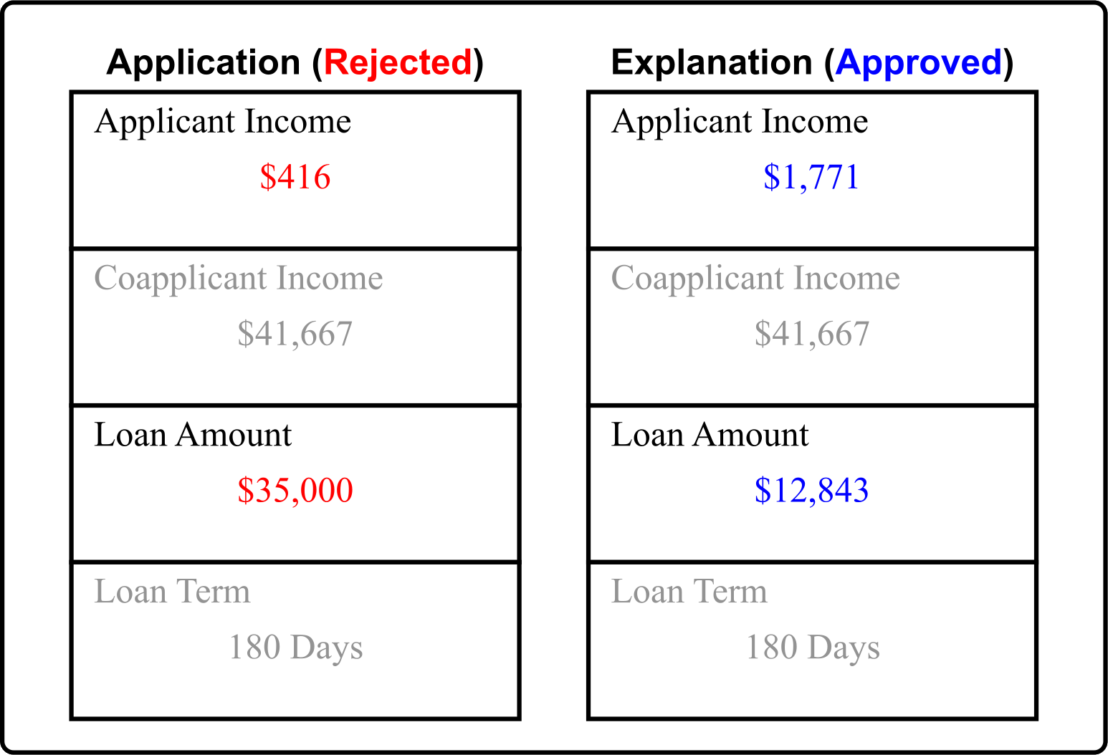
Methods: Explanation Configurations
Numeric
Natural Language
Visual
Point
Region
Notes:
Numeric example

Slide 20
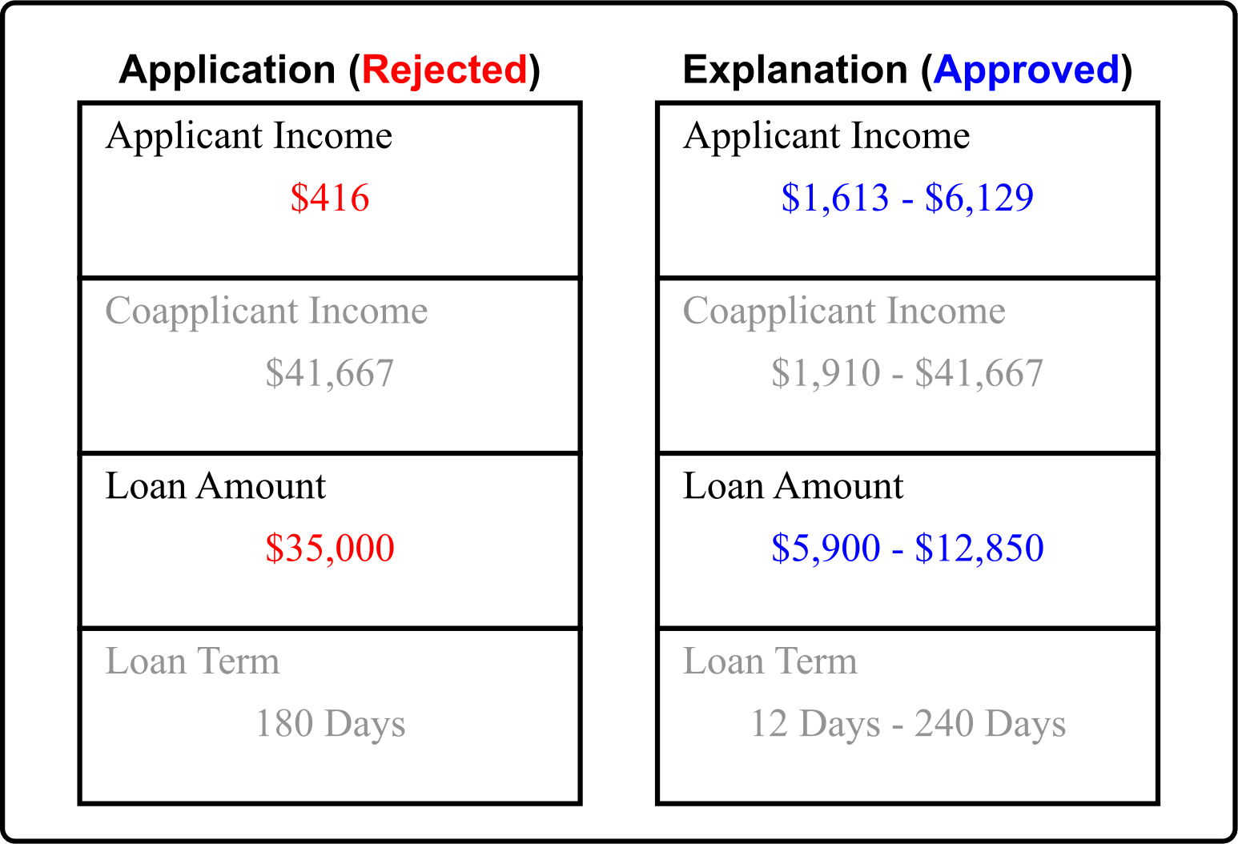
Methods: Explanation Configurations
Numeric
Natural Language
Visual
Point
Region
Notes:
Numeric region

Slide 21
Methods: Explanation Configurations
Numeric
Natural Language
Visual
Point
Region
Notes:
Numeric region

Slide 22
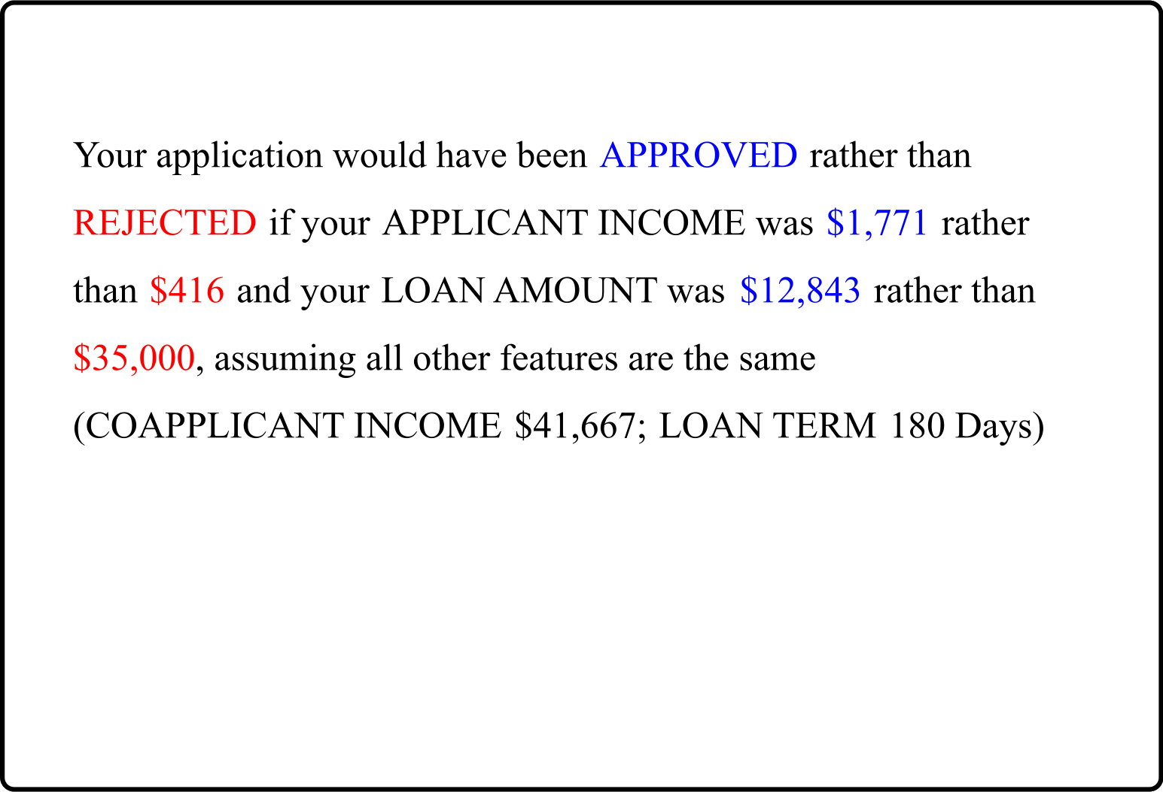
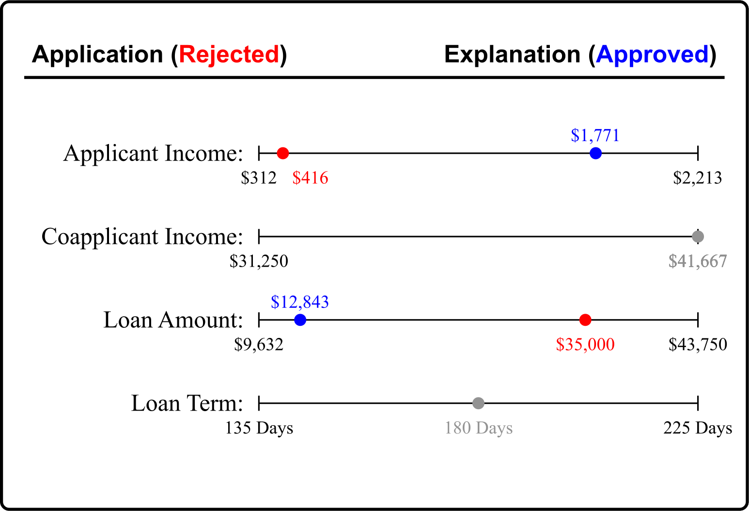
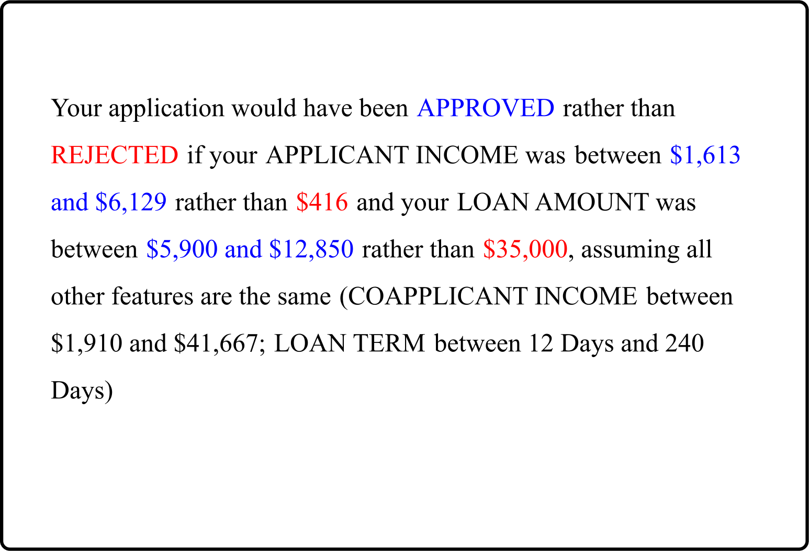
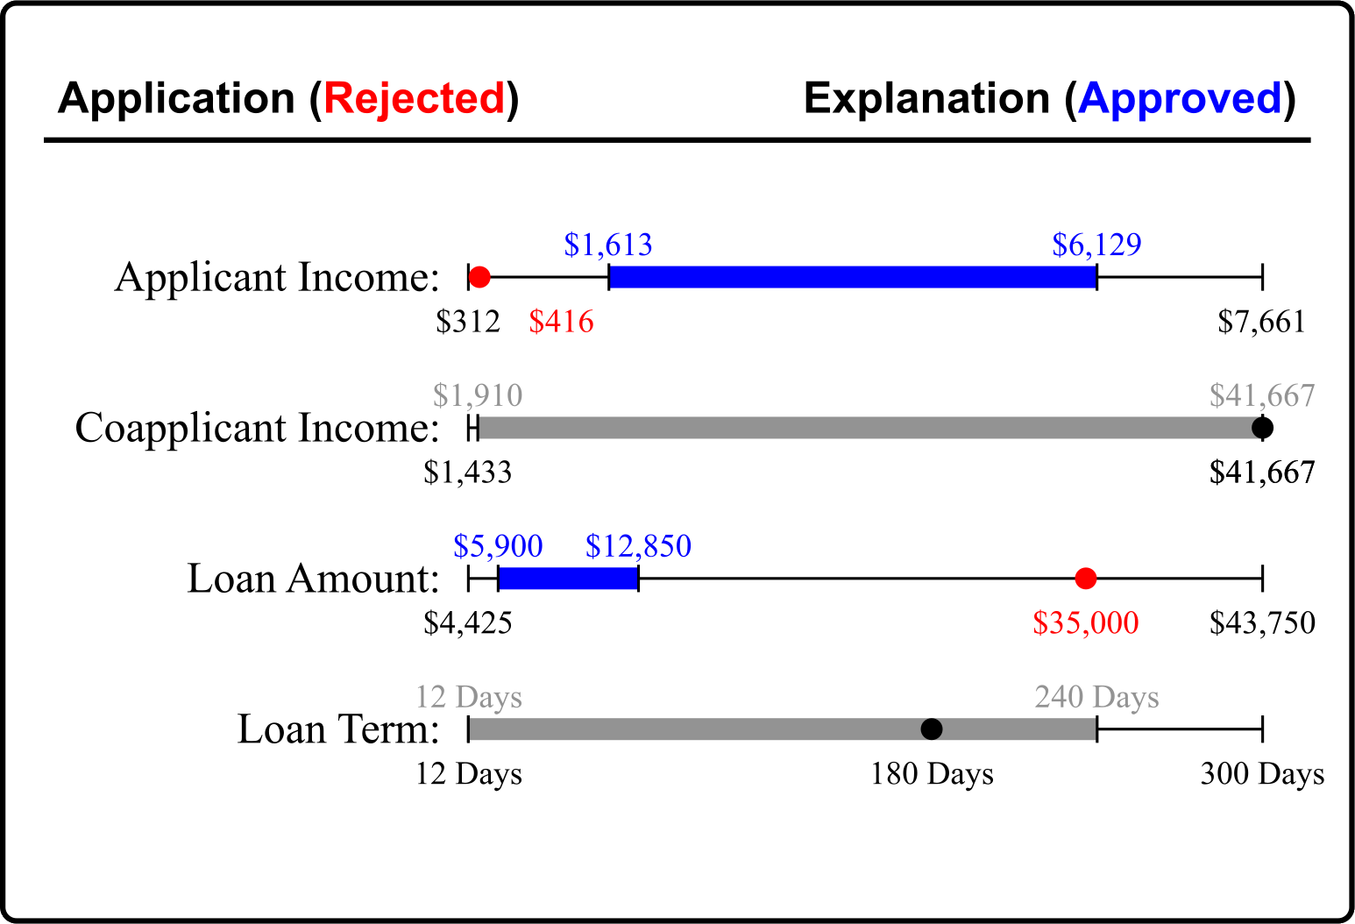
Methods: Explanation Configurations
Numeric
Natural Language
Visual
Point
Region
Notes:
Numeric region

Slide 23
Methods: Explanation Configurations
Numeric
Natural Language
Visual
1
2
3
Point
Region
4
5
6
2x3 between subjects experiment

Slide 24
Methods: Explanation Configurations
Numeric
Natural Language
Visual
Point
Region
2x3 between subjects experiment

Slide 25
Methods: Explanation Configurations
Numeric
Natural Language
Visual
Point
Region
2x3 between subjects experiment

Slide 26
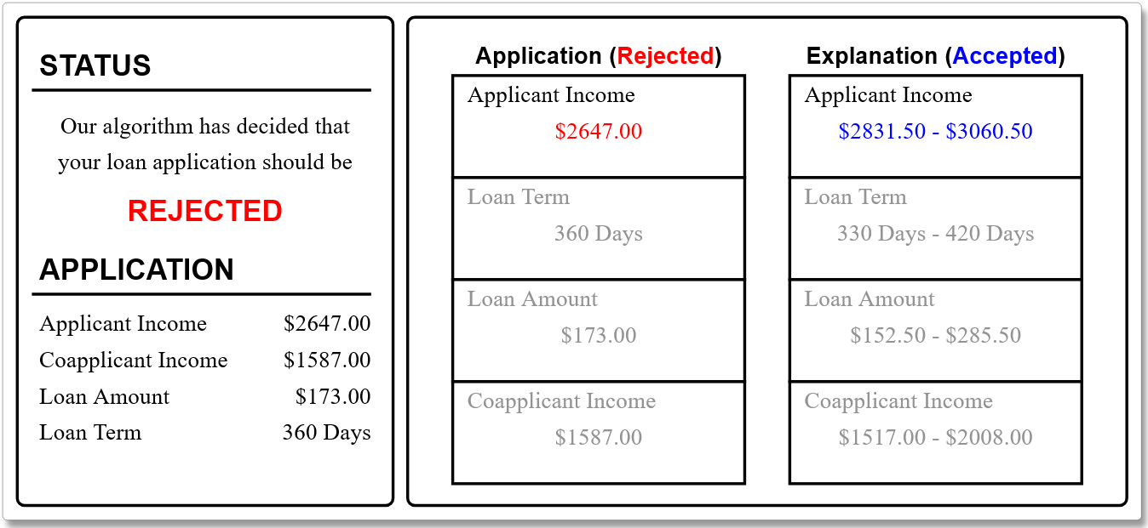
Methods: Explanation User Interface
1
3
1
Application status
(always rejected)
2
Application values
3
Explanation area, changes between independent variables
2
4
Response area
4
Which change is most likely to get this application approved?
(a)
Decreasing Loan Amount to $30,000
(b)
Increasing Applicant Income to $2,000
(c)
Neither would increase the chance of approval

Slide 27
Methods: Explanation User Interface
1
3
1
Application status
(always rejected)
2
Application values
3
Explanation area, changes between independent variables
2
4
Response area
Main Metrics
4
Which change is most likely to get this application approved?
Objective Understanding
Subjective Understanding
Response Confidence
(a)
Decreasing Loan Amount to $30,000
✔
(b)
Increasing Applicant Income to $2,000
(c)
Neither would increase the chance of approval
score responses 0/1 and sum

Slide 28
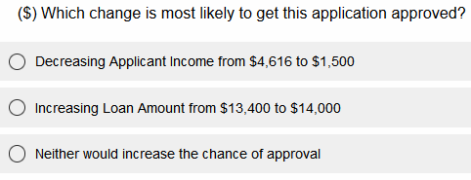
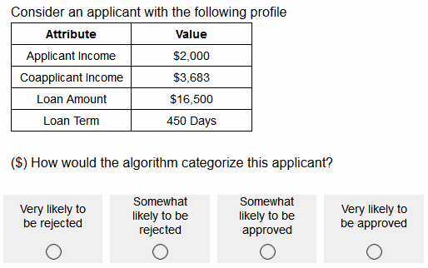
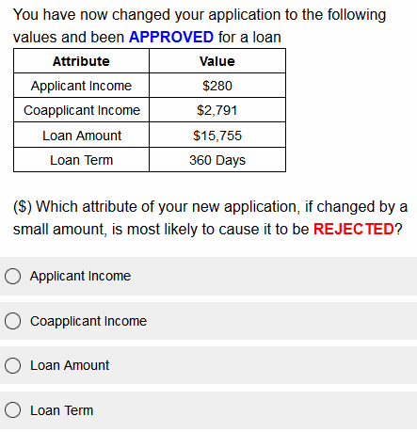
Metric: Objective Understanding
Task 1: Feature Alteration
Correctly interpret proposed alterations
Task 2: Instance Prediction
Check instance’s fitness to an explanation
Task 3: Feature Sensitivity
Recognize marginal counterfactual values

Slide 29
Metric: Subjective Understanding
Please indicate how much you agree with the following statements
 | Strongly Disagree | Disagree | Somewhat Disagree | Somewhat Agree | Agree | Strongly Agree
Explanations of the algorithm are easy to understand
Given an explanation I can reliably predict how the algorithm will behave
Explanations of the algorithm help me understand how the approval decision is made
Explanations of the algorithm help me increase the likelihood of getting my application approved
I understand the criteria for loan approval

Slide 30
Results: Responses
264 Participants from Prolific.com
US English Speaking Adults
$4 base payment + up to $2 bonus
~$14.98/hr
Analysis: Multi-way ANOVA and Multiple Linear Regressions
Notes:
Smallest group 39 largest group 43
https://www.flaticon.com/free-icon/team_11454277
https://www.flaticon.com/free-icon/age_5229570
https://www.flaticon.com/free-icon/map_5866208
https://www.flaticon.com/free-icon/money_2704332
https://www.flaticon.com/free-icon/dollars_7630510
https://www.flaticon.com/free-icon/clock_2997300

Slide 31
Results: Main Findings
RQ1: Effects of counterfactual style and presentation on user understanding
$H_{1a}$: Regions increase objective understanding
$H_{1b}$: Presentation moderates objective understanding
$H_{1c}$: Regions increase subjective understanding
$H_{1d}$: Presentation effects subjective understanding

Slide 32
Results: Main Findings
RQ1: Effects of counterfactual style and presentation on user understanding
$H_{1a}$: Regions increase objective understanding
$H_{1b}$: Presentation moderates objective understanding
$H_{1c}$: Regions increase subjective understanding
$H_{1d}$: Presentation effects subjective understanding
RQ2: Effects of counterfactual style and presentation on user confidence
$H_{2a}$: Regions increase response confidence
$H_{2b}$: Presentation moderates response confidence

Slide 33
Results: Main Findings
RQ1: Effects of counterfactual style and presentation on user understanding
$H_{1a}$: Regions increase objective understanding
$H_{1b}$: Presentation moderates objective understanding
$H_{1c}$: Regions increase subjective understanding
$H_{1d}$: Presentation effects subjective understanding
RQ2: Effects of counterfactual style and presentation on user confidence
$H_{2a}$: Regions increase response confidence
$H_{2b}$: Presentation moderates response confidence
RQ3: Subjective understanding and response confidence predict objective understanding
$H_{3a}$: Subjective understanding predicts objective understanding
$H_{3b}$: Response confidence predicts objective understanding

Slide 34
Discussion & Future Work
Effect of Counterfactual Explanation Style
Counterfactual region explanations hold significant promise for improving calibrated lay user understanding
Recommend ML practitioners explore this area for more model architectures and tasks
Effect of Counterfactual Explanation Presentation
Well designed explanation presentations are possible across multiple modalities
Presentation can affect user confidence and could impact ease of use
Encourage UI designers and HCI experts to examine broader presentation designs
Future Work
Evaluate user understanding from counterfactuals in additional domains and with alternate user populations

Slide 35
Thank You!
Checkout our paper for full analysis, qualitative results, and more!
petervannostrand.github.io
Actionable Recourse for Automated Decisions: Examining the Effects of Counterfactual Explanation Type and Presentation on Lay User Understanding
Peter M. VanNostrand, Dennis M. Hofmann, Lei Ma, and Elke A. Rundensteiner.
ACM FAccT 2024

