Slide 1
ELITE: Robust Deep Anomaly Detection with Meta Gradient
Huayi Zhang†, Lei Cao*, Peter VanNostrand†, Samuel Madden*, Elke Rundensteiner†
WPI, DAISY Lab†
MIT, CSAIL*
hzhang4@wpi.edu, lcao@csail.mit.edu
Notes:
Hi everyone, I am Huayi Zhang. The title of my talk is …. This is a joint work with my collaborators, ….

Slide 2
Background & Motivation

Slide 3
What is an Anomaly?
Anomaly: A data sample that does not conform to the expected behavior.
Credit card fraud detection
Unusual Location
Massachusetts
California
Credit card transaction
Notes:
What is an anomaly? An anomaly is …. For example, in a credit card fraud detection task, if all transactions are happened in Massachusetts, but one transaction that happens in California, this transaction is unusual, and can be considered as an anomaly.

Slide 4
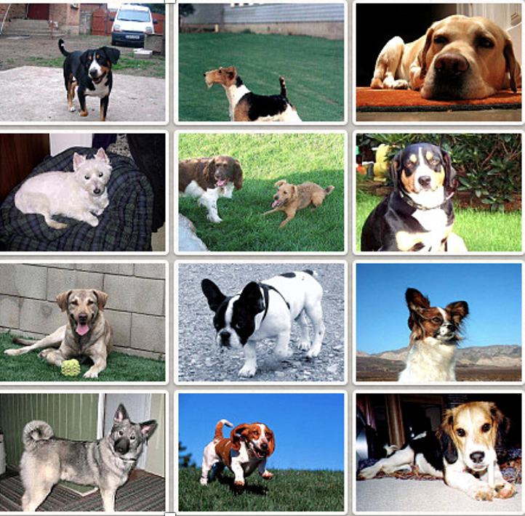
What is Deep Anomaly Detection?
Detect Anomalies with Deep Learning techniques (on complex datasets).
Images
Text
Time Series
Notes:
The deep anomaly detection problem refers to the methods that detect anomalies with deep learning techniques, usually on complex datasets.

Slide 5
How does Deep Anomaly Detection work?
Learns the distribution of normal samples.
Commonly unsupervised since labeled anomalies are rare.
Any “out-of-distribution” samples are rejected
Normal Sample
Anomaly
Notes:
The core methodology of deep anomaly detection method is to learn the distribution of normal samples. Then any sample that doesn’t belong to the learned distribution is rejected as an anomalies. Since the anomalies are often rare in applications, the deep anomaly detection methods are often unsupervised.

Slide 6
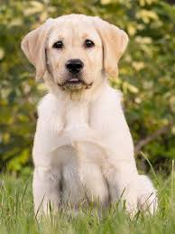
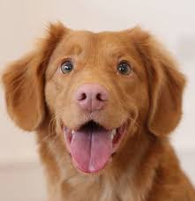
Unsupervised Deep Anomaly Detection
Assumption: All training data are normal samples.
Training Objective: Minimize anomalous score on all training data.
Unlabeled Set
Model
Train
Normal
Learns the distribution of training samples.
Notes:
The unsupervised deep anomaly detection methods assume all training data are normal samples. Then they train the deep learning models, such as Auto-Encoder to learn the distribution of entire training dataset. By minimizing the average training loss, the models are assumed to capture the distribution of normal samples. That is, all normal samples are expected to have small testing loss. Then, any sample with large training loss is predicted as an anomaly.

Slide 7
Semi-supervised Deep Anomaly Detection
Improve unsupervised models with labeled anomalies.
Penalize small anomalous score on labeled anomalies.
Unlabeled Set
(Small) Labeled Set
Model
Train
Normal
Normal & Anomalous
Improved Model
Notes:
There are also some methods that leverages a small amount of labeled samples to improve the deep anomaly detection models. Here, by labeled samples, I refer to the labeled dataset that contains both labeled anomalies and labeled normal samples. The training mechanism is the same to the standard semi-supervised classification method, that is, using the labeled samples as the training data to compensate the unsupervised loss.

Slide 8
Limitations of Deep Anomaly Detection
Training data sets are often polluted, i.e., contain anomalies.
Anomalies in training data contaminate the learned distribution.
Anomalous test samples cannot be detected.
Normal Sample
Unlabeled Anomaly
Test Anomaly
Notes:
A critical open question to the both unsupervised and supervised deep anomaly detection problem is that in real applications, people often only have polluted datasets, that is the datasets contain both normal samples and anomalies. In this case, the learned distribution will be contaminated by the training data. And consequently, the anomalies might not be detected by the deep anomaly detection models.

Slide 9
Robust Deep Anomaly Detection
Objective: Trains a good model with polluted training data.
Anomalous test samples can be detected.
Normal Sample
Unlabeled Anomaly
Test Anomaly
Notes:
The robust deep anomaly detection problem address this polluted training data problem. The objective of robust deep anomaly detection is to train a good anomaly detection model with polluted training data, that is, learn the distribution of normal samples on polluted training data.

Slide 10
Related Works

Slide 11
Related Works
 | Polluted Training Data (Large and Complex) | Small Set of Labeled Data (Very Rare, e.g., <50)
Unsupervised Robust Deep Anomaly Detection
Semi-supervised Deep Anomaly Detection
ELITE
Challenge
Method
Notes:
Our work tackle two open challenges in real word data anomaly detection task, that is leveraging a large and complex polluted dataset, and very small set of labeled anomalies, for example, smaller than 50, to train a good deep anomaly detection model.

Slide 12
Proposed Methods

Slide 13
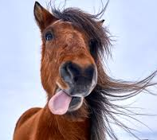
Overview of ELITE
Utilizes labeled set as validation data to infer labels of polluted data.
(Large) Unlabeled Set
(Small) Labeled Set
Model
Train
Validate
Normal & Anomalous
Normal & Anomalous
Pseudo Labels
Validation loss
Pseudo Label Inference
Notes:
The key idea of ELITE is to utilize the labeled samples as validation data to guide training process.More specifically, every training sample is assigned a pseudo label, indicating if it is a normal sample or an anomaly.

Slide 14
ELITE Training Scheme
Training Samples
(Small) Labeled Set
Input
Validate
Update
$$θ_{t+1}$$
$$θ_{t}$$
Which pseudo label should be altered?
Notes:
Since training sample one by one is too slow, especially when the training set is large. It’s natural to consider training with multiple samples together. However, we might have some challenges in this case. That is, simply compare validation loss difference cannot tell us which pseudo label causes the validation loss increasing, since multiple samples are load into the model together.

Slide 15
ELITE Training Scheme
Training Samples
(Small) Labeled Set
Input
Validate
Update
$$θ_{t+1}$$
$$θ_{t}$$
Notes:
Since training sample one by one is too slow, especially when the training set is large. It’s natural to consider training with multiple samples together. However, we might have some challenges in this case. That is, simply compare validation loss difference cannot tell us which pseudo label causes the validation loss increasing, since multiple samples are load into the model together.

Slide 16
Estimate Validation Loss Difference with Meta-Gradient
Meta-Gradient:
Widely used in optimization based meta-learning and other tasks.
$$θ$$
$$M≈∇_{θ }L\left(θ_{t}\right)∙∇_{θ }L^{v}\left(θ_{t}\right)$$
$$∇_{θ }L\left(θ_{t}\right)$$
Gradient of
training sample loss
Gradient of validation set loss
$$∇_{θ }L\left(θ_{t}\right)$$
Similar gradient
Correct pseudo label
$$∇_{θ }L^{v}\left(θ_{t}\right)$$
Opposite gradient
Incorrect pseudo label
Refer to our paper for more details.
Notes:
To solve this problem, we use the technique called meta-gradient, which is widely used in optimization based meta learning and other tasks, such as robust deep learning, semi-supervised learning, and neural network architectures search. One way to interpret meta-gradient is considering it as the inner product between the gradient of validation loss and training loss. When these two gradient are similar, it indicates the gradient of training sample loss may also reduce the validation loss. Otherwise, this means the training sample may increase the validation loss, and the pseudo label is incorrect.

Slide 17
Experiments

Slide 18
Research Questions Explored
Q1. Robustness to polluted training data.
In this talk
Q2. Performance with different number of labels.
Q3. Sensitivity analysis of hyper-parameters.
Q4. Training mechanism.
Notes:
In the experiments, we explores the following research questions. …
I this talk, I will briefly discuss results of experiments of the first two questions.

Slide 19
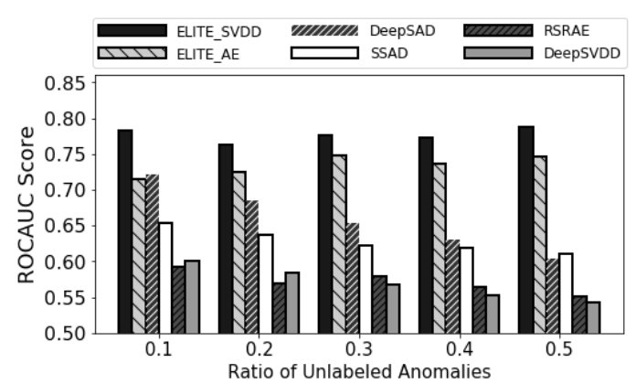
Q1: Robustness to Polluted Training Data
Varying ratio of unlabeled anomalies: 10% - 50%.
Dataset: CIFAR-10
Num. of labels: 50 normal + 50 anomalous
Methods:
ELITE on unsupervised DeepSVDD Model^{[1]}
ELITE on unsupervised Auto-Encoders Model
STOA Semi-supervised Deep Model^{[2]}
STOA Semi-supervised Shallow Model^{[3]}
STOA unsupervised Deep Model^{[1]}
STOA unsupervised Robust Deep Model^{[4]}
Result: Outperforms all other methods by up to 30%
Notes:
First, to evaluate the robustness to polluted training data, we vary the ratio of unlabeled anomalies from 10% to 50%. Here I use the cifar-10 data set and fashion-mnist dataset as an example. On the challenging cifar-10 dataset, with 100 labeled exampels, which is 2% of whole dataset. And on fashion-mnist dataset, we use 20 labels in total. On both datasets, our method significantly outperforms the others. Also, we observe that the ROCAUC score of ELITE is very stable, even if we increase the pollution ratio to 50%. Note both the first and second results are based on our method, as we apply our method on different end anomaly detection models.

Slide 20
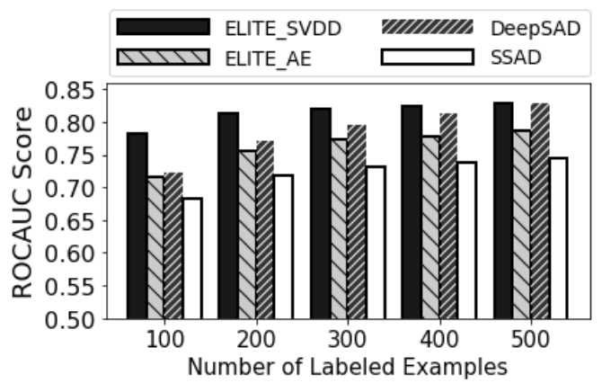
Q2: Performance with Different Number of Labels
Varying number of labels: 100 - 500
Dataset: CIFAR-10
Ratio of unlabeled anomaly: 10%
Methods:
ELITE on unsupervised DeepSVDD Model^{[1]}
ELITE on unsupervised Auto-Encoders Model
STOA Semi-supervised Deep Model^{[2]}
STOA Semi-supervised Shallow Model^{[3]}
Result: Reaches high accuracy with very few labeled examples.
Notes:
Second, we evaluate the performance of related methods with different number of labels. We vary the number of labels from 100 to 500 for cifar10 dataset, and 20 to 100 for fmnist dataset. From the result, we find that ELITE achieves very good accuracy given very few labeled examples, while the related methods requires much more labels to achieve similar ROCAUC score.

Slide 21
Conclusion

Slide 22
Conclusion
A robust deep anomaly detection method that utilizes labeled anomalies.
An optimization paradigm for robust deep anomaly detection which uses labeled samples as the validation data.
An efficient training schema that infers the labels of training data on every training iteration.
Our method outperforms state-of-the-art methods by up to 30% in ROC-AUC score on various benchmark datasets.
Notes:
As a collusion, in this work we propose …

Slide 23
Acknowledgement
This research was supported in part by the National Science Foundation under grants IIS-1910880, CSSI-2103832, CNS-1852498 and by the U.S. Dept. of Education under grant P200A180088.
Notes:
We are grateful to the grant support from national science foundation and us department of education.

Slide 24
Reference
[1] Ruff, Lukas, et al. "Deep one-class classification." International conference on machine learning. PMLR, 2018.
[2] Ruff, Lukas, et al. "Deep semi-supervised anomaly detection." arXiv preprint arXiv:1906.02694 (2019).
[3] Görnitz, Nico, et al. "Toward supervised anomaly detection." Journal of Artificial Intelligence Research 46 (2013): 235-262.
[4] Lai, Chieh-Hsin, Dongmian Zou, and Gilad Lerman. "Robust subspace recovery layer for unsupervised anomaly detection. " arXiv preprint arXiv:1904.00152 (2019).

Slide 25
Thank You

