Slide 1

Options Without Agency
Diversity as a Requirement for Fair Actionable Recourse
Peter M. VanNostrand, Dennis M. Hofmann, Lei Ma, and Elke A. Rundensteiner
ACM FAccT 2026
June 25th – 28th
Peter VanNostrand, PhD Candidate
Worcester Polytechnic Institute
petervannostrand.github.io

Slide 2




Algorithmic Decision Making is Everywhere
>90% of F500 companies use automated applicant screening^{[1]}
85% of banks use ML in lending and investment decisions^{[2]}
49 States use ML in pre-trial detention and parole decisions^{[3]}
65% of US Hospitals use AI models in patient care^{[4]}
[1] Hidden Workers: Untapped Talent, Harvard Business School Survey, 2021
[2] Transforming Paradigms: A Global AI in Financial Services Survey, University of Cambridge, 2020
[3] Liberty at Risk: Pre-trial Risk Assessment Tools in the U.S., Electronic Privacy Information Center, 2022
[4] Current Use And Evaluation Of Artificial Intelligence And Predictive Models In US Hospitals, Health Affairs, 2025
Notes:
ML vs AI terms
Make citations darker/bigger

Slide 3

REJECTED
ACTION
ACCEPTED
Actionable Recourse
The action must be feasible for the user to enact
The action results in the user receiving their desired outcome

Slide 4









Counterfactual Explanations for Actionable Recourse
Counterfactual explanations describe actions that would change an instance such that a different outcome would occur
$$f$$
REJECTED
Decision Making Model
$$x$$
Income | Rent | Savings | Debt
$2,000 | $1,500 | $4,000 | $850
$$+$$
Reject
$$x^{′}=x+a$$
$$a$$
Income | Rent | Savings | Debt
+$2,000 | +$0 | +$2,000 | +$0
Accept
$$a$$
$$=$$
$$x$$
ACCEPTED
$$x^{′}$$
Income | Rent | Savings | Debt
$4,000 | $1,500 | $6,000 | $850

Slide 5





Counterfactual Explanations for Actionable Recourse
Feasibility is not universal as users have unique personal preferences and constraints and on what changes they can enact
REJECTED
Great!
$$x$$
Income | Rent | Savings | Debt
$2,000 | $1,500 | $4,000 | $850
No Way!
$$+$$
1
Income | Rent | Savings | Debt
+$2,000 | +$0 | +$2,000 | +$0
2
$$a$$
$$=$$
ACCEPTED
$$x^{′}$$
Income | Rent | Savings | Debt
$4,000 | $1,500 | $6,000 | $850

Slide 6




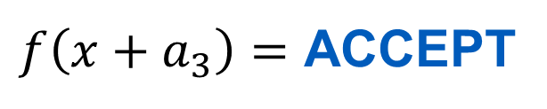








Counterfactual Explanations for Actionable Recourse
It’s often necessary to provide users with multiple paths to recourse so they can find an action that is practically achievable for them and suits their preferences
1
2
$f\left(x+a_{1}\right)=$ ACCEPT
$$a_{1}:$$
Reject
$$x_{1}^{′}$$
$$x_{2}^{′}$$
$$x_{3}^{′}$$
Accept
$$a_{1}$$
$$a_{2}$$
$f\left(x+a_{2}\right)=$ ACCEPT
$$a_{2}:$$
$$a_{3}$$
$$x$$
$f\left(x+a_{3}\right)=$ ACCEPT
$$a_{3}:$$
Feasibility

Slide 7
Does this seem fair?

Slide 8




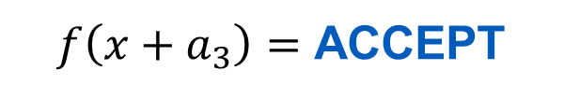








Can Recourse Explanations Be Unfair?
Users who get a more desirable set of counterfactual explanations are more likely to obtain recourse in practice and thus gain life changing resources/opportunities
1
2
$f\left(x+a_{1}\right)=$ ACCEPT
$$a_{1}:$$
easy
Reject
$$x_{1}^{′}$$
$$x_{2}^{′}$$
$$x_{3}^{′}$$
Accept
$$a_{2}$$
$f\left(x+a_{2}\right)=$ ACCEPT
$$a_{2}:$$
medium
$$a_{1}$$
$$a_{3}$$
$$x$$
$f\left(x+a_{3}\right)=$ ACCEPT
$$a_{3}:$$
hard
Feasibility
This is unfair if it results from factors that are arbitrary or unrelated to the task, especially if those factors include membership in a marginalized group

Slide 9
How can we measure recourse fairness?

Slide 10







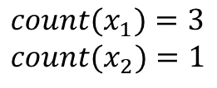























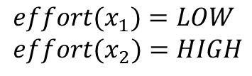






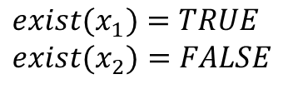






State-of-the-Art Recourse Fairness Metrics
(a) Recourse Existence^{[5-7]}
(b) Recourse Count^{[8,9]}
(c) Recourse Effort^{[5,7,8-11]}
$$a_{1}$$
$$a_{1}$$
$$a_{1}$$
$$a_{1}$$
$$a_{2}$$
$$a_{2}$$
$$a_{2}$$
$$a_{2}$$
$$x_{1}$$
$$a_{3}$$
$$x_{1}$$
$$a_{3}$$
$$a_{6}$$
$$x_{1}$$
$$a_{3}$$
$$a_{3}$$
$$a_{5}$$
$$a_{4}$$
$$x_{1}$$
$$a_{1}$$
$$a_{4}$$
$$a_{5}$$
$$a_{1}$$
$$a_{6}$$
$$a_{2}$$
$$a_{2}$$
$$a_{3}$$
$$x_{2}$$
$$a_{3}$$
$$x_{2}$$
$$x_{2}$$
$$x_{2}$$
$${exist(x}_{1})=TRUE$$
$${exist(x}_{2})=FALSE$$
$${exist(x}_{1})=exist\left(x_{2}\right)$$
$${exist(x}_{1})=exist\left(x_{2}\right)$$
$${exist(x}_{1})=exist\left(x_{2}\right)$$
$${count(x}_{1})=3$$
$${count(x}_{2})=1$$
$${count(x}_{1})=count\left(x_{2}\right)$$
$${count(x}_{1})=count\left(x_{2}\right)$$
$${effort(x}_{1})=LOW$$
$${effort(x}_{2})=HIGH$$
$${effort(x}_{1})=effort\left(x_{2}\right)$$
Outcomes
Individuals
Fairness
[05] Ehyaei et al., Robustness Implies Fairness in Causal Algorithmic Recourse, FAccT ‘23
[06] Artelt et al., Evaluating Robustness of Counterfactual Explanations, IEEE SSCI ‘21
[07] Ustun et al., Actionable Recourse in Linear Classification, FAccT ‘19
[08] Bynum et al., A New Paradigm for Counterfactual Reasoning in Fairness and Recourse, IJCAI ‘24
[09] Kavouras et al., Fairness Aware Counterfactuals for Subgroups, NeurIPS ‘23
[10] Kügelgen et al., On the Fairness of Causal Algorithmic Recourse, AAAI ‘22
[11] Gupta et al., Equalizing Recourse Across Groups, arXiv ‘19
Reject
Group 1
Fair
Accept
Group 2
Unfair

Slide 11




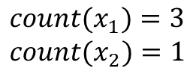

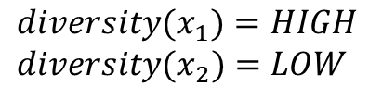





















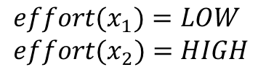












State-of-the-Art Recourse Fairness Metrics
(a) Recourse Existence^{[5-7]}
(b) Recourse Count^{[8,9]}
(c) Recourse Effort^{[5,7,8-11]}
(d) Recourse Diversity - Ours
$$a_{1}$$
$$a_{1}$$
$$a_{1}$$
$$a_{1}$$
$$a_{2}$$
$$a_{2}$$
$$a_{2}$$
$$a_{2}$$
$$x_{1}$$
$$a_{3}$$
$$x_{1}$$
$$a_{3}$$
$$a_{6}$$
$$x_{1}$$
$$a_{3}$$
$$a_{3}$$
$$a_{5}$$
$$a_{4}$$
$$x_{1}$$
$$a_{1}$$
$$a_{4}$$
$$a_{5}$$
$$a_{1}$$
$$a_{6}$$
$$a_{2}$$
$$a_{2}$$
$$a_{3}$$
$$x_{2}$$
$$a_{3}$$
$$x_{2}$$
$$x_{2}$$
$$x_{2}$$
$${exist(x}_{1})=TRUE$$
$${exist(x}_{2})=FALSE$$
$${exist(x}_{1})=exist\left(x_{2}\right)$$
$${exist(x}_{1})=exist\left(x_{2}\right)$$
$${exist(x}_{1})=exist\left(x_{2}\right)$$
$${count(x}_{1})=3$$
$${count(x}_{2})=1$$
$${count(x}_{1})=count\left(x_{2}\right)$$
$${count(x}_{1})=count\left(x_{2}\right)$$
$${effort(x}_{1})=LOW$$
$${effort(x}_{2})=HIGH$$
$${effort(x}_{1})=effort\left(x_{2}\right)$$
$${diversity(x}_{1})=HIGH$$
$${diversity(x}_{2})=LOW$$
Great! This is totally fair. Right?
Outcomes
Individuals
Fairness
Reject
Group 1
Fair
This case is intuitively unfair, but existing metrics overlook this fact
Accept
Group 2
Unfair

Slide 12
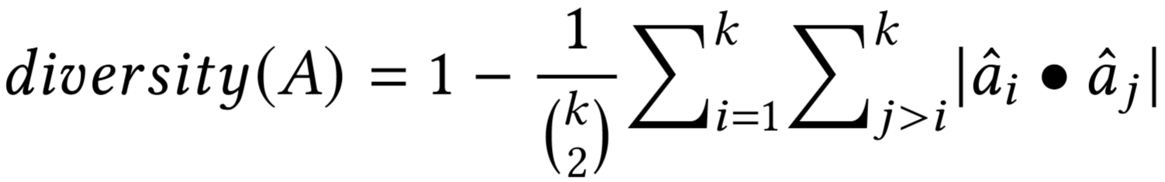
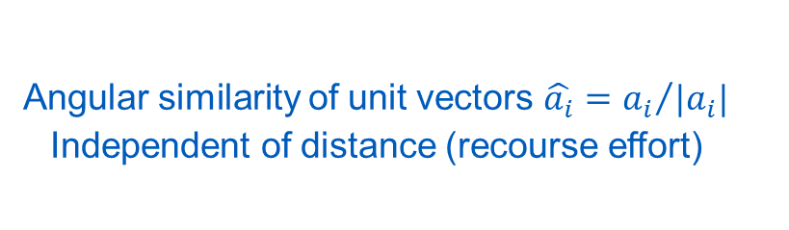
Recourse Diversity
We design recourse diversity to measure the agency a user has to choose their path to recourse
Therefore, we base diversity on the similarity among a set of counterfactual actions
Given a set of $k$ counterfactual actions $A=\left\{a_{1},a_{2},…,a_{k}\right\}$
Mean pairwise similarity of actions
Independent of orientation
Independent of number of actions (recourse count)
Angular similarity of unit vectors $\hat{a_{i}}={a_{i}}/{|a_{i}|}$
Independent of distance (recourse effort)
Diversity measures how well a set of actions is distributed with respect to the explained instance, and diversity is orthogonal to existing recourse fairness metrics

Slide 13

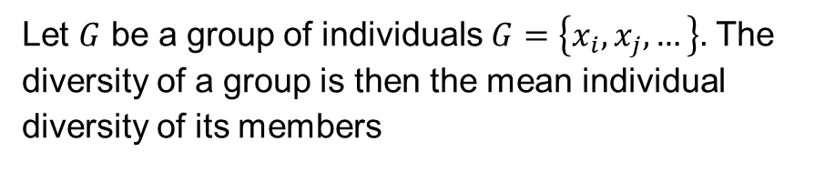
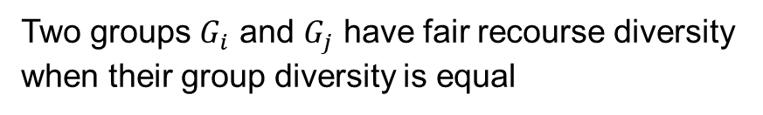
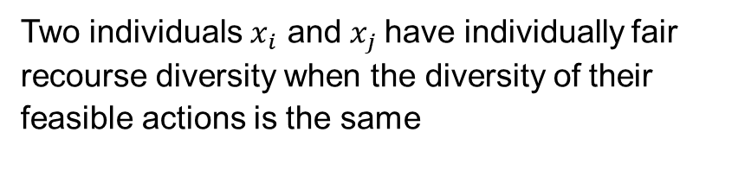
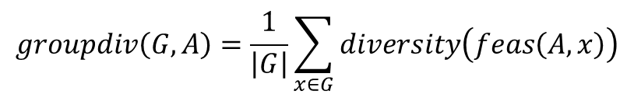
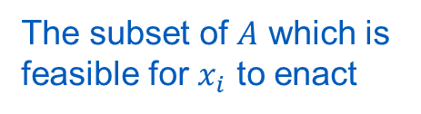
Individual and Group Fair Recourse Diversity
Individually Fair Recourse Diversity
GrOUP Fair Recourse Diversity
Two individuals $x_{i}$ and $x_{j}$have individually fair recourse diversity when the diversity of their feasible actions is the same
Let $G$ be a group of individuals $G=\left\{x_{i}, x_{j}, …\right\}.$ The diversity of a group is then the mean individual diversity of its members
$$diversity\left(feas\left(A,x_{i}\right)\right)−diversity\left(feas\left(A,x_{j}\right)\right)=0$$
$$groupdiv\left(G,A\right)=\frac{1}{\left|G\right|}\sum_{x∈G}{diversity\left(feas\left(A,x\right)\right)}$$
The subset of $A$ which is feasible for $x_{i}$ to enact
Two groups $G_{i}$ and $G_{j}$ have fair recourse diversity when their group diversity is equal
$$groupdiv\left(G_{i},A\right)−groupdiv\left(G_{j},A\right)=0$$

Slide 14
Do real models produce disparities in recourse diversity?
How does diversity compare to existing recourse fairness metrics?

Slide 15

Auditing Individual Recourse Fairness
Compare the counterfactual actions for individuals who differ solely in race and/or sex
Generate Synthetic Twins
Compare Explanations
Race
Sex
Profile
Twin 1
VS
Real
Real Individual
Race
Sex
Profile
Race
Sex
Profile
Twin 2
VS
Real
Race
Sex
Profile
Twin 3
VS
Real
Repeat for 5 stratified random samples of 20 individuals per intersection. A fair model would have no change in recourse effort or recourse diversity

Slide 16
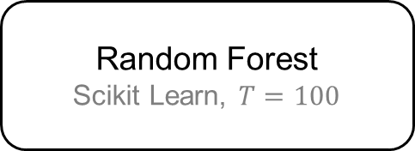
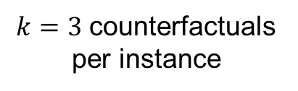
Experimental Setting
4 Benchmark Datasets
3 Model Architectures
2 CF Explainers
Adult Income^{[12]}
Logistic Regression
Scikit Learn, Defaults
Heuristic Explainer^{[16]}
k-nearest CF points from walk along random rays
COMPAS Recidivism^{[13]}
Random Forest
Scikit Learn, $T=100$
German Credit^{[14]}
DICE^{[17]}
Uses IP to find k “diverse” CFs by maximizing distance between pairs of CFs while minimizing distance to x
Neural Network
Keras, 4 layers, 10 nodes
GiveMeCredit^{[15]}
Financials and demographics including race, sex, or both
80/20 train-test split
$k=3$ counterfactuals per instance
[12] Becker and Kohavi, UCI Machine Learning Repository Adult, 1996
[13] AI Fairness 360, Compas Dataset, 2024
[14] Hans Hofmann, UCI Machine Learning Repository Statlog (German Credit Data), 1994
[15] Kaggle, Give Me Some Credit, 2021
[16] Leofante, Promoting Counterfactual Robustness through Diversity, AAAI 2024
[17] Mothilal, Explaining Machine Learning Classifiers through Diverse Counterfactual Explanations, FAccT 2020

Slide 17
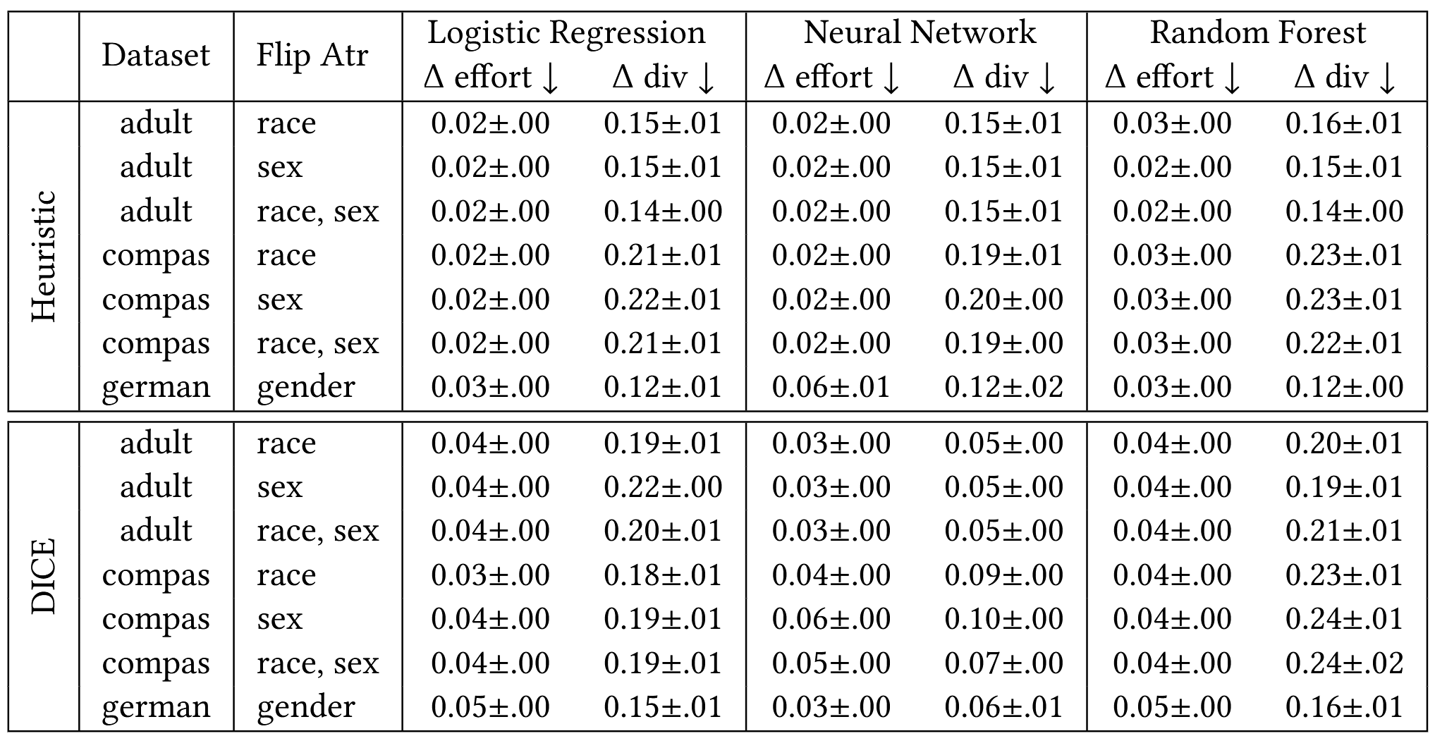

Auditing Individual Fairness w.r.t. Race/Sex
All models have individually
fair recourse effort
with both explainers
LR and RF have individually
unfair recourse diversity
with both explainers
NN has individually…
unfair recourse diversity
with Heuristic explainer
fair recourse diversity with DICE explainer
For many people changing their race/sex would not provide easier paths to recourse, but would provide more meaningfully distinct choices for how to do so
Recourse diversity detects this difference in fairness while recourse effort does not

Slide 18


Auditing Group Fairness
Subpopulation Groups
White Women < 30 y.o.
Groups where $\left(Sex=Female\right)$
Population
White Women <30 y.o.
Women With PhDs
Married Black Men
Rule Mining
Split By Predicate
VS
Unemployed White Men
$$\text{Groups} \text{where} \left(Sex=Male\right)$$
$$⋯$$
Married Black Men
Unemployed White Men
Women With PhDs

Slide 19
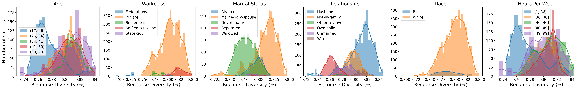
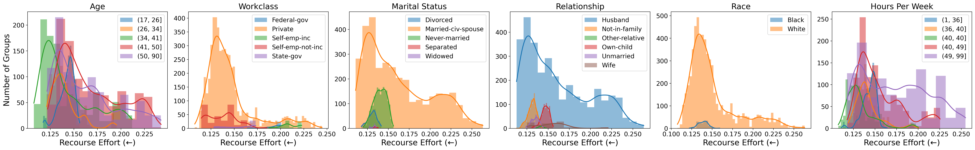
Auditing Group Fairness – Diversity and Effort
Adult Credit Dataset – Logistic Regression Classifier
frequency
Increasing diversity (better)
frequency
Increasing effort (worse)
Recourse diversity shows that groups with certain feature-values have more/less agency when choosing a recourse path

Slide 20
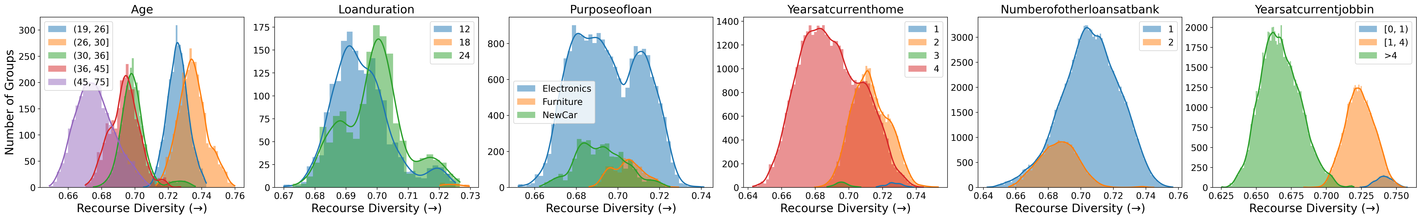
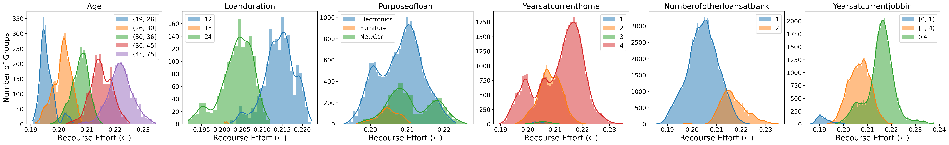
Auditing Group Fairness – Diversity and Effort
German Credit Dataset – Logistic Regression Classifier
Older age = lower diversity
More experience = lower diversity
Older age = higher effort
More experience = higher effort
In some cases, groups with specific feature-values can be doubly disfavored i.e., receive the lowest diversity and highest effort explanations

Slide 21
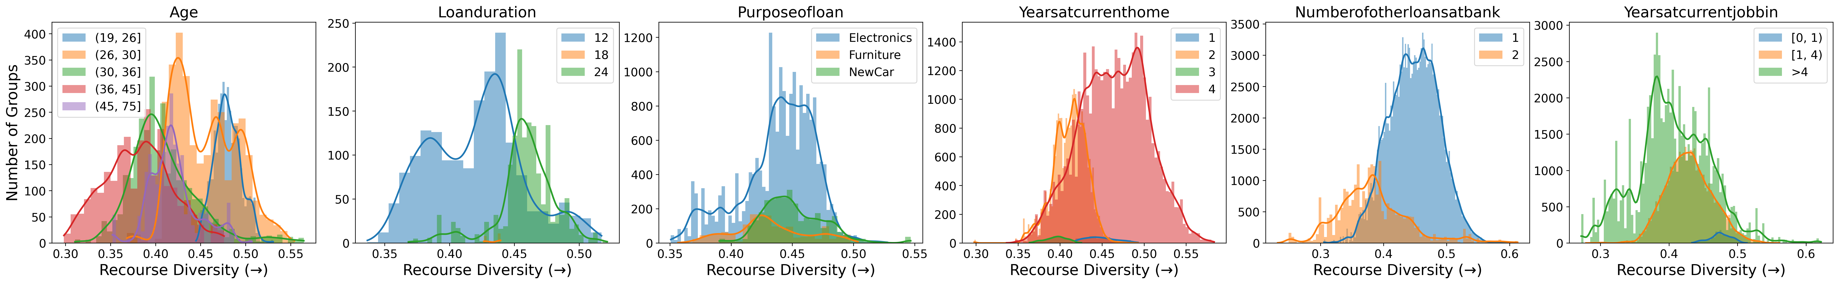
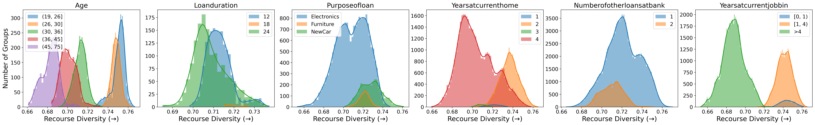
Auditing Group Fairness – Model Architecture
German Credit Dataset – LR (top), NN (middle), RF (bottom)
Logistic Regression Diversity
Neural Network Diversity
Random Forest Diversity

Slide 22
Auditing Group Fairness – Model Architecture
German Credit Dataset – LR (top), NN (middle), RF (bottom)
Older age = lower diversity
More years = lower diversity
More experience = lower diversity
Older age = lower diversity
more years = higher diversity
Older age = lower diversity
more years = lower diversity
More experience = lower diversity

Slide 23
Auditing Group Fairness – Model Architecture
German Credit Dataset – LR (top), NN (middle), RF (bottom)

Slide 24
Discussion
Individual Recourse Fairness
Explanations for recourse can be fair in terms of recourse existence, count, and effort, yet remain unfair in terms of diversity, giving some individuals more agency to choose their recourse path
Real ML models can produce highly disparate recourse diversity based solely on differing race/sex
Group Recourse Fairness
Across multiple datasets, machine learning models favored groups with specific feature-values by producing explanations with higher diversity or lower effort
Some groups were doubly disfavored by receiving the least desirable scores on both metrics
Effects of Model Selection
Different model architectures can treat the same groups differently; sometimes favoring the same groups and other times reversing which feature-values are preferred
Different architectures can produce substantially different overall diversity, with the best explanations from one model being less desirable than the worst explanations from another

Slide 25
Takeaways
For Fairness Auditors
Recourse fairness in general, and recourse diversity in particular, should be considered important parts of fairness auditing as they can strongly affect who has access to critical opportunities and whether they have the power make choices that meaningfully affect their life.
For Machine Learning Practitioners
Model multiplicity suggests that there are many models suitable for a given task. Practitioners should consider recourse fairness during model development to explore whether models exist that provide equal predictive power while being fairer to individuals seeking recourse.

Slide 26
Thank You!
Checkout our paper for additional results, extended discussion, and practical recommendations
petervannostrand.github.io
Options Without Agency: Diversity as a Requirement for Fair Actionable Recourse
pvannostrand@wpi.edu
Peter M. VanNostrand, Dennis M. Hofmann, Lei Ma, and Elke A. Rundensteiner
ACM FAccT 2026

